Slide 1
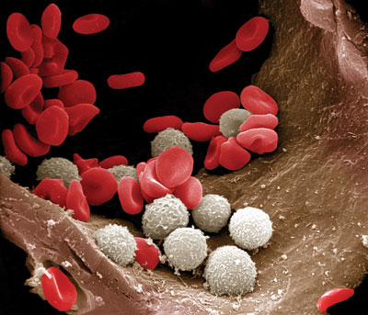
Leukocytes
Formation, Function and Pathology
Clinical Pathology
VTHT 2323
Lori VanValkenburg, RVT

Slide 2
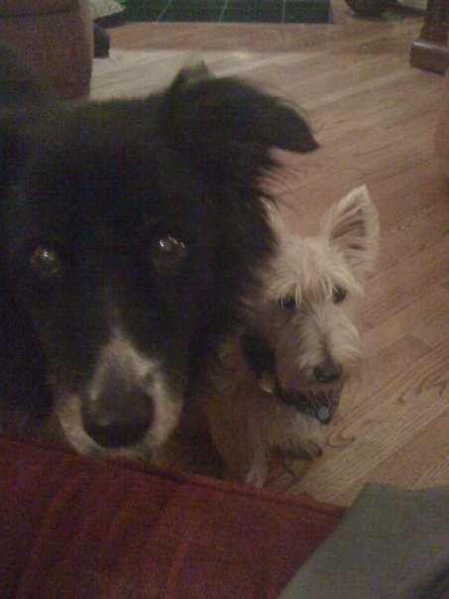
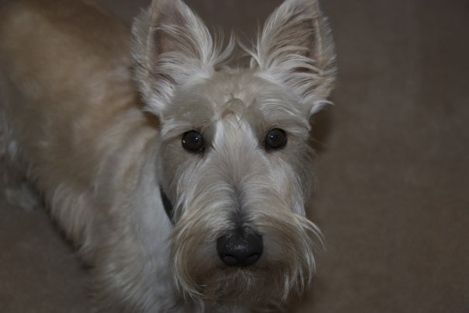
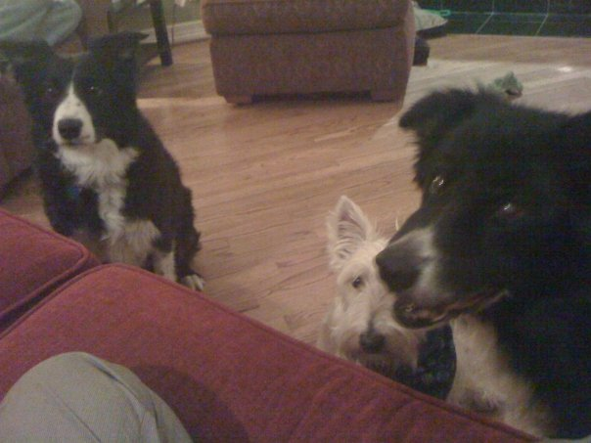
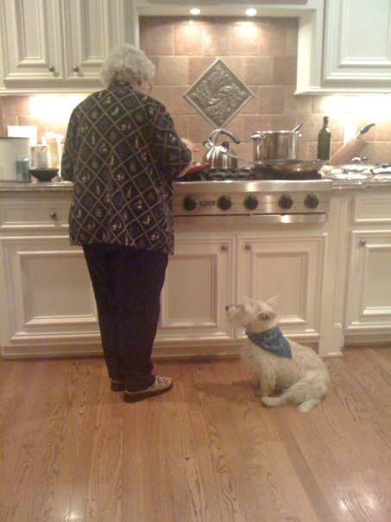
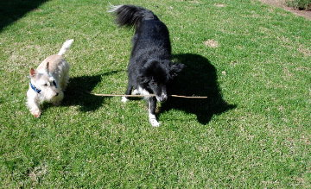
Alissa Woodall’s Pets
Jazzy, Boggie & Shadow
Boggie
Boggie & Shadow

Slide 3
Leukopoiesis
All WBC production starts out in red bone marrow from the same PPSC that produces RBCs.
The stimuli that act on the PPSC determine which cell type will be produced.
Each WBC has its own stimulus for production.
All WBCs differentiate and develop in the bone marrow except for some lymphocytes which start out in bone marrow but develop elsewhere.
At the beginning of leukopoiesis, all WBCs look alike (in the bone marrow)

Slide 4
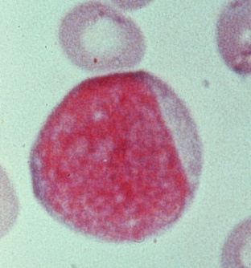
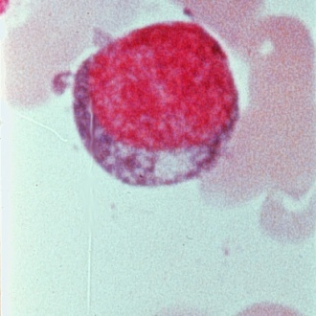
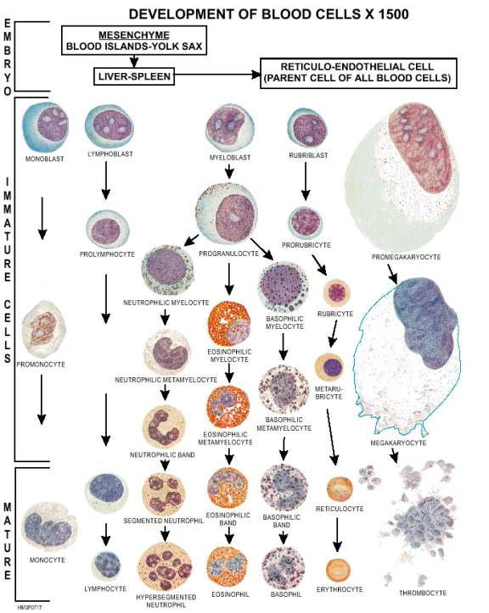
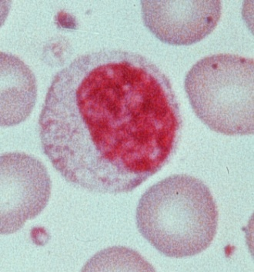
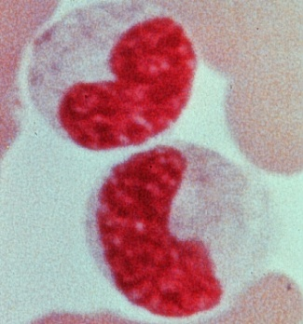
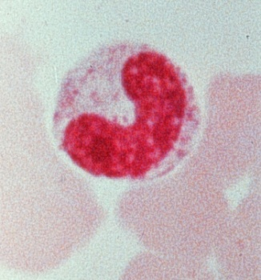
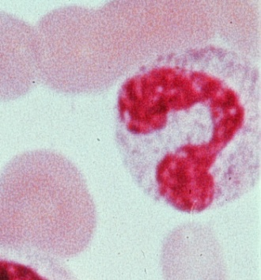
Leukopoiesis
Granulopoiesis
  1. Stem cell 2. Myeloblast
  3. Promyelocyte 4. Myelocyte
  5. Metamyelocyte 6. Band cell
  7. Mature cell (segmented neutrophil, basophil or eosinophil)

Slide 5
Granulocytes
Granulocytes: eosinophils (pick up acidic stain – red), basophils (pick up basic stain – blue) and neutrophils (do not pick up either stain very well)
Originally all have no granules present
As cells mature, nonspecific granules develop which are the same in all 3 types of granulocytes.
Eventually specific granules replace the nonspecific granules and determine the function of the granulocyte.
  Eosinophil granules contain antiinflammatory substances
  Neutrophil granules contain lysosomal enzymes
  Basophil granules contain histamine and heparin

Slide 6
Neutrophils
Note: Neutrophils are also known as PMNs (polymorphonuclear cells) because their nuclei have many shapes or “segs” because their nuclei are segmented.
Formation: It takes 3-5 days to produce a mature neutrophil (from a PPSC) under normal conditions; however, if a sudden need arises, this time can be shortened.
Average time spent in bloodstream is only about 10 hrs. before entering the tissues (can also be shortened if demand is increased in tissues).
Once a neutrophil enters the tissue, it does not return to blood; therefore, circulating neutrophils need to be replaced about 2.5 times per day.
Band neutrophils indicate an increased demand beyond what the bone marrow can supply. If bone marrow runs out of bands it will release progressively more immature cells.

Slide 7
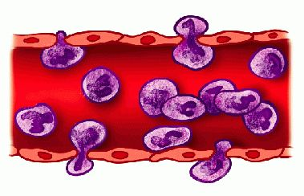
Functions: First line of defense when invaders enter the body because they can respond very quickly.
Neutrophils are phagocytes with lysosome granules that contain digestive enzymes (such as phagocytin) that can destroy bacteria and viruses once engulfed.
Neutrophils (and other WBCs) leave blood vessel via diapedesis, a process where they squeeze between the cells of the endothelium and enter the tissues.

Slide 8
Neutrophils are normally found in tissues that are constantly susceptible to invasion by microorganisms such as the lungs and intestinal tract.
Other neutrophils wander through tissue to sites where they are needed.
Normally neutrophils stay in tissue until they die of old age or die an untimely death in the face of battle.
Dead or abnormal neutrophils are disposed of by tissue macrophages.

Slide 9
!Attack of the Neutrophils!
1. Chemotaxis – the process by which neutrophils (and other cells) are attracted to a site of infection by inflammatory chemicals produced by the interaction between microorganisms and the tissues they are invading.
2. Neutrophils recognize foreign microorganisms and encase them within a membrane-bound vacuole known as a phagosome (give them a really big hug). They are surrounded by the neutrophil membrane, but not really inside the neutrophil.

Slide 10
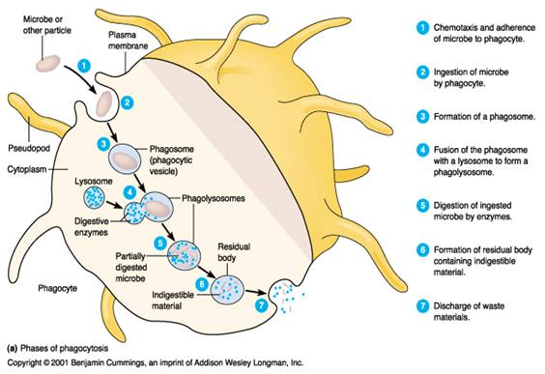
3. Cytoplasmic granules of the neutrophil move to the edge of the phagosome that contains the microorganisms, fuse with the membrane, and secrete their digestive enzymes into the vacuole.
4. During ingestion, neutrophils produce substances that are toxic to ingested bacteria such as myeloperoxidase, lysozyme and hydrogen peroxide

Slide 11
Normal Neutrophil Count in Blood
The neutrophil count in peripheral blood is kept within a specific range (dogs: 3,000 – 11,400/µL; cats: 2,500 – 12,500/µL) in healthy animals and is controlled by the following factors:
Release of mature neutrophils from the storage pool in the bone marrow into the peripheral blood.
    5-day supply, “on call” and ready for immediate release incase neutrophils are suddenly sent from blood into tissues
Rate of escape from peripheral blood into tissue.
    With a massive, acute infection, total neutrophil population in peripheral blood can enter the tissue within a couple of hours
Entrance of increased numbers of PPSCs into the neutrophil production line.
    Slow method of control; it takes 3 to 6 days for neutrophils to mature for release

Slide 12
Intravascular Pools of Neutrophils
The Circulating Neutrophil Pool (CNP) refers to the blood contained in the blood vessels.
  Blood samples obtained for laboratory analysis contain neutrophils from this pool.
  The normal range for neutrophils is based on those contained in this pool
The Marginal Neutrophil Pool (MNP) is composed of neutrophils that line the walls of small blood vessels (not circulating).
  These neutrophils are not contained in blood sampled for laboratory analysis.

Slide 13
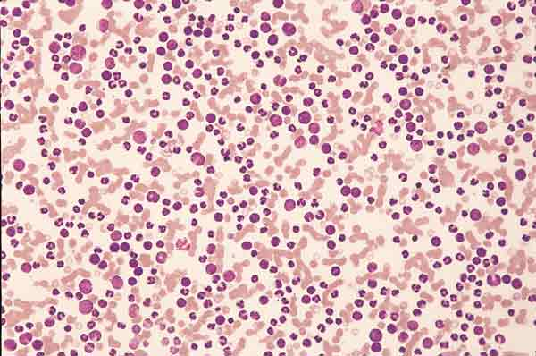
Neutrophilia
An increase in neutrophils will increase the total number of WBCs in blood circulation (leukocytosis)
To meet increased demand for neutrophils in tissue, the bone marrow releases its reserve stores of mature, and if necessary, immature neutrophils into the blood.
If a blood sample is drawn while these neutrophils are in transit, a higher than normal number of neutrophils will be included in the sample (neutrophilia)

Slide 14
Neutrophilia
Physiologic leukocytosis: Exercise, fear, or excitement that causes a release of epinephrine resulting in a shift of neutrophils from the MNP to the CNP
  No left shift occurs
  Count usually not more than twice the normal value
  Should return to normal within 30 minutes of removal of stimulus
  Additionally, splenic contraction releases WBC & RBC into circulation: may have lymphocytosis
  Most common in cats

Slide 15
Neutrophilia
Stress Response: Corticosteroid-induced
  Treatment with exogenous steroids
  Endogenous steroids released in response to major systemic illnesses, metabolic disturbances, and pain
  Neutrophil count nearly doubles – mature neutrophilia
  No left shift/ Shift from MNP to CNP
  Stress Leukogram: expect to see neutrophilia, lymphopenia and eosinopenia (and often monocytosis in dogs)

Slide 16
Neutrophilia
Other causes of neutrophilia include:
  Inflammation – mild inflammation yields a leukocyte response similar to stress; severe inflammation yields neutrophilia with a left shift.
  Bacterial infections
  Conditions associated with extensive tissue damage:
    Burns, necrosis, trauma, extensive surgery, neoplasia
  Extreme leukocytosis (with neutrophilia) may be associated with neoplasms that produce colony-stimulating factors:
    Hepatozoon canis infections, leukemias, and closed cavity infections (i.e. pyometra, abscesses)

Slide 17
Leukemia – Literally means “White blood”. Caused by malignant proliferation of one of the WBC types.
  In response to some unknown stimulus, stem cells in bone marrow start producing abnormal cells in one cell line at an increased rate.
  Abnormal cells show up in blood and bone marrow in large numbers, usually before they are mature and cause a dramatic increase in total WBC count.
  Leukemias are considered a form of cancer and can be acute or chronic.
  Classified by type of cell involved
Leukemia and leukocytosis may resemble one another; sometimes the distinction is difficult.

Slide 18
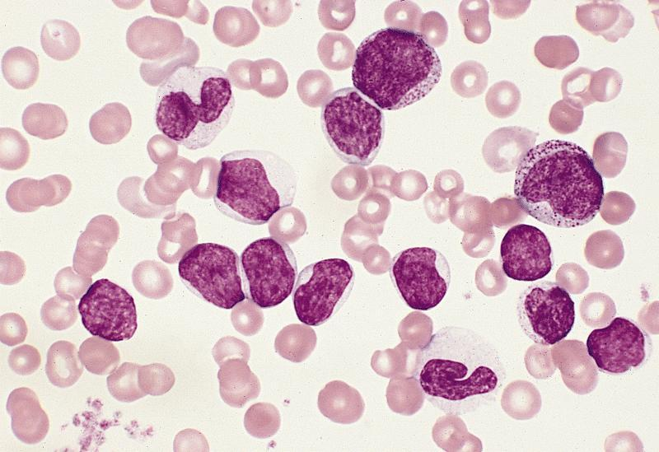
Leukemoid Response: A marked leukocytosis (total WBC count > 50,000/µL) with neutrophilia and a left shift back to at least myelocytes associated with an inflammatory condition.
  Named because it resembles blood pattern seen in chronic myeloid leukemia
  Localized, purulent inflammatory condition, such as pyometra, should be suspected when a leukemoid response is present.

Slide 19
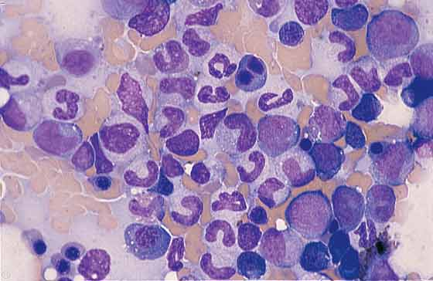
Left Shifts
Characterized by an increase in band (immature) neutrophils in the blood.
  Note: It is normal for 0-300/µL band cells to be present in the blood of a healthy canine/feline.
Usually associated with inflammatory conditions
Indicate that stimulus for release of neutrophils from bone marrow is greater then can be accommodated by release from mature neutrophil stores alone.
Left shifts vary from slight (slightly increased number of bands) to severe (metamyelocytes, myelocytes, and rarely- even promyelocytes present in blood)
Toxic cytoplasm often present during left shifts

Slide 20
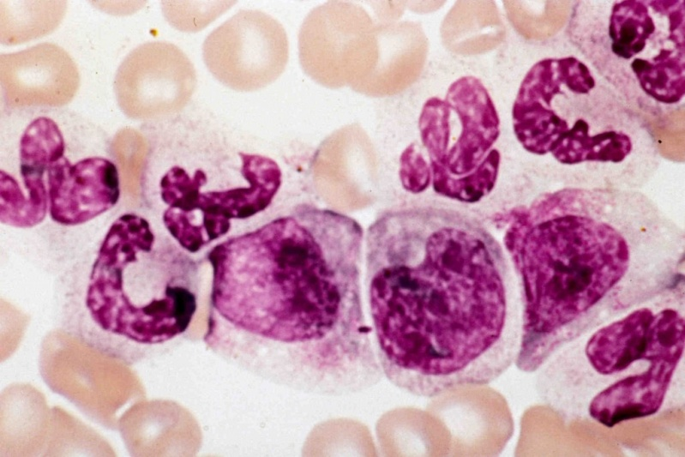
Left shifts
Regenerative Left Shift - Neutrophilia with some band cells present; however, mature, segmented neutrophils predominate.
Degenerative Left Shift – Neutropenia where immature neutrophils outnumber mature neutrophils
  Usually result of extreme migration of cells into tissues and/or detrimental effects of toxins.

Slide 21
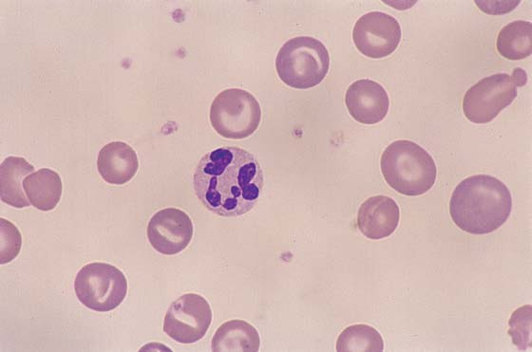
Right shift
Hypersegmentation – refers to the presence of 5 or more distinct nuclear lobes within neutrophils.
A right shift reflects prolonged transit time of neutrophils in blood and can occur as a result of:
  Resolving chronic inflammation
  Glucocorticoid administration
  Hyperadrenocorticism (Cushing’s disease)
  Myeloproliferative disorders
May develop in-vitro when blood film preparation is delayed for more than a few hours.

Slide 22
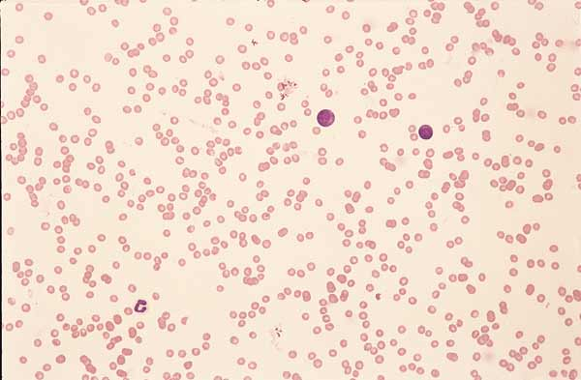
Neutropenia
Neutropenia will cause the total WBC count to decrease (leukocytopenia)
If an infection is out of control, all the reserves of neutrophils can be used up faster than the bone marrow can replace them.
Such a condition signifies that the body is losing the war against the invading microorganisms.
Prognosis is poor for a critically ill animal that has neutropenia and leukocytopenia

Slide 23
Neutropenia
Neutropenia can occur due to:
  Margination of neutrophils (pseudoneutropenia)
  Excessive tissue demand or destruction of neutrophils
    Destruction can be immune-mediated
  Reduced or ineffective granulopoiesis
Conditions that cause neutropenia:
  Overwhelming bacterial infections (ex: septicemia)
  Idiosyncratic drug reactions may result in neutropenia or pancytopenia (e.g. penicillins, cephalosporins, sulfonamides in dogs and chloramphenicol in cats)
  Feline Leukemia Virus
  Canine Cyclic Neutropenia (a.k.a. Gray Collie Syndrome)

Slide 24
Eosinophils
Formation: It takes 2 to 6 days to produce an eosinophil from a PPSC.
The bone marrow has a good reserve of eosinophils.
Circulating and marginal pools are also found in peripheral blood (like neutrophils).
Eosinophils migrate into tissue in just a few hours where they spend the rest of their lives and undergo the same aging process as neutrophils.

Slide 25
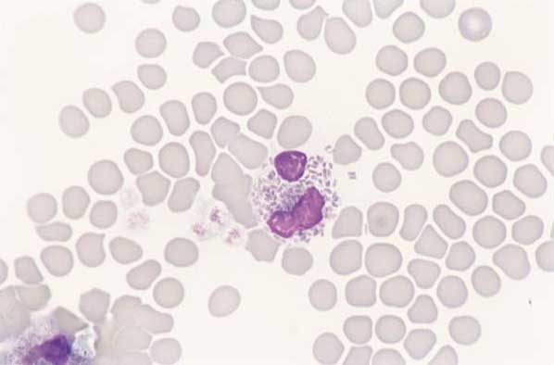
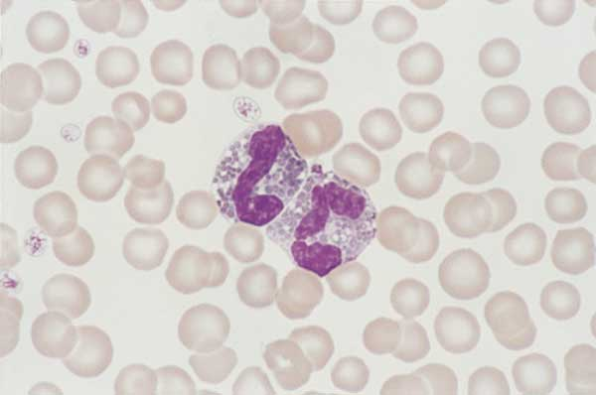
Eosinophils
Functions
Eosinophils are attracted to and inhibit local allergic and anaphylactic (hypersensitivity) reactions
  Their granules contain anti-inflammatory substances that are released at the site of the allergic reaction.
They ingest substances associated with the humoral immune response (antigen-antibody reaction complexes)
They have minimal phagocytotic and bactericidal functions
    They are especially effective in phagocytosis of large pathogenic organisms, such as protozoa, and some parasitic worms but are not protective against most bacterial infections.
Above: feline eosinophil (left), canine eosinophil (right)

Slide 26


Slide 27
Eosinophils
Normal Eosinophil Values: (dogs: 100-750/µL; cats: 0 – 750/µL)
Eosinophilia is usually a result of:
  Parasites
    Skin, respiratory, GI tract
  Hypersensitivity
  Immunoglobulin, IgE, causes mast cell degranulation which, in turn, attracts eosinophils via chemotaxis
  Reactions and/or inflammation
  Anaphylaxis
  Fleas, food, grasses, non-specific allergens
  Feline asthma
  Hypereosinophilic syndrome in cats (usually fatal)
  Chronic inflammation (skin, GI, respiratory, urogenital)
  Tumor associated (fibrosarcoma, mast cell tumor, lymphoma, etc.)
Eosinopenia is difficult to detect and evaluate because their numbers are normally low.

Slide 28
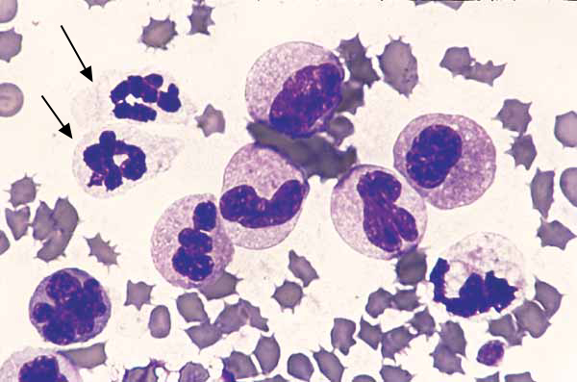
Feline eosinophilic leukemia. Two neutrophils (arrows) are adjacent to several eosinophils at various stages of development that include segmented, band, metamyelocyte, and myelocyte forms

Slide 29
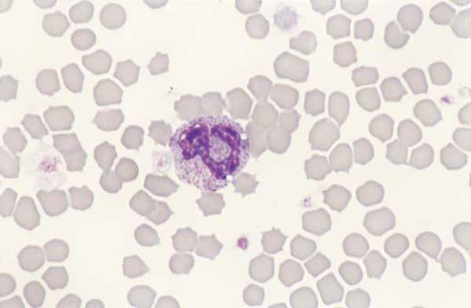
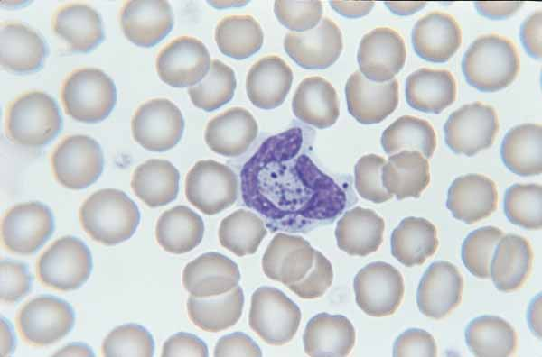
Basophils
Formation: Basophils are produced in the bone marrow from the same PPSCs as other cells
Characteristics: The granules of basophils are water soluble and often washed out during the staining procedure; therefore, they are not always visible on a stained smear.
Function: Basophils are the least phagocytic of the granulocytes. Their granules contain histamine and heparin which are responsible for at least part of their function (not much is known about basophil production or function).
Above: feline basophil (left); canine basophil (right)

Slide 30
Basophil Function
Histamine and heparin granules
  Histamine helps initiate inflammation and acute allergic reactions.
  Eosinophils are attracted to the site of an allergic reaction by eosinophilic chemotactic factor released from the granules.
  Heparin acts as a localized anticoagulant to keep blood flowing to an injured or damaged area.

Slide 31
Basophilia and Basopenia
Normal Basophil Values: (dogs: rare; cats: rare)
Basophilia can be associated with an allergic or hypersensitivity reaction in the tissue.
  Sometimes basophilia and eosinophilia are seen at the same time.
Basopenia is not clinically significant. Basophils should make up less than 1% of all WBCs in peripheral blood.

Slide 32
Agranulocytes
Agranulocytes are cells that do not have specific staining granules in their cytoplasm. They include monocytes and lymphocytes.
Monocytes are formed in the bone marrow from the PPSC population.
  (Maturation: 1. monoblast – 2. promonocyte – 3. monocyte)
Lymphocytes originate from the PPSC in the bone marrow; however some travel to lymphoid organs to develop and mature before settling into their permanent home in peripheral lymphoid tissue.

Slide 33
Monocytes
Formation: Mature much faster and stay in the blood longer than neutrophils. Total development time is 24-36 hours then they stay in the blood for 24-36 hours before entering tissue where they carry out their function.
Function: Major phagocytic cells; are known as tissue macrophages once in the tissues.
Monocytes in the blood are considered immature tissue macrophages and are less effective phagocytes than they are in the tissue.

Slide 34
Monocytes
Monocytes enter tissue by the process of chemotaxis in response to tissue damage caused by trauma or invading microorganisms.
Neutrophils respond more quickly to tissue damage, but monocytes stay around longer once they reach the damaged site and become macrophages.
Monocytes can also function in circulating blood to phagocytize damaged blood cells or microorganisms found in the blood (septicemia).

Slide 35
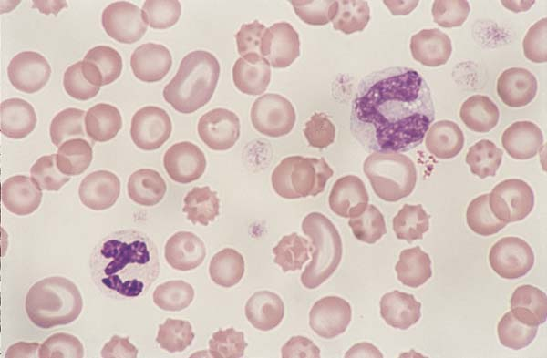
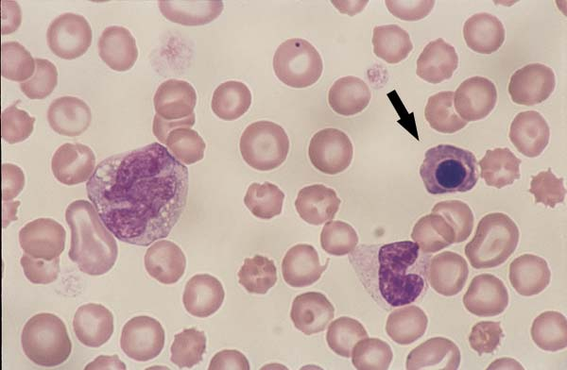
Monocytes
Canine monocytes. Monocytes are slightly larger than a neutrophil and have a blue-grey cytoplasm, lobulated nucleus, and a lacy chromatin pattern. The monocyte (left) contains a few round clear cytoplasmic vacuoles. A band neutrophil and an NRBC (arrow) are on the right (100x).
Canine monocytes. Monocytes are slightly larger than a neutrophil and have a blue-grey cytoplasm, lobulated nucleus, and a lacy chromatin pattern. A segemented neutrophil (left) and a monocyte (right).

Slide 36
Tissue Macrophages
Larger than monocytes in bloodstream
Are most prevalent in “filter” organs such as the liver, spleen, lung, and lymph nodes.
Some tissue macrophages are free and wander through tissue, while others become fixed in specific tissues and remain there for the rest of their life span (e.g. Kupffer’s cells).
Macrophages are often associated with chronic infections since they have a longer life span than neutrophils.
Collectively, the tissue macrophages and monocytes are known as the mononuclear phagocyte system.

Slide 37
The Mononuclear Phagocyte System
Functions:
  Clean up cellular debris that remains after inflammation or infection is resolved
  Antigen processing cells. The MPS can ingest antigens and present them on their cell membranes to the lymphocytes, which will destroy them.
  Have ability to form multinucleated giant cells in the tissue in response to foreign bodies (ex: granulomas).
  Ingest foreign substances.
    Capable of pinocytosis and phagocytosis. Can engulf structures beyond the phagocytic capacity of neutrophils such as fungi, protozoa, viruses, and dead neutrophils.
  Are a major source of colony stimulating factors , cytokines that regulate inflammatory responses.

Slide 38
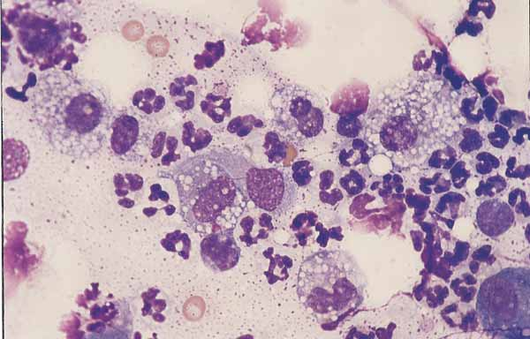
Fine needle aspirate of a granulomatous skin lesion. Neutrophils are adjacent to large macrophages that have abundant vacuolated cytoplasm and round to oval nuclei. Macrophages are derived from blood monocytes

Slide 39
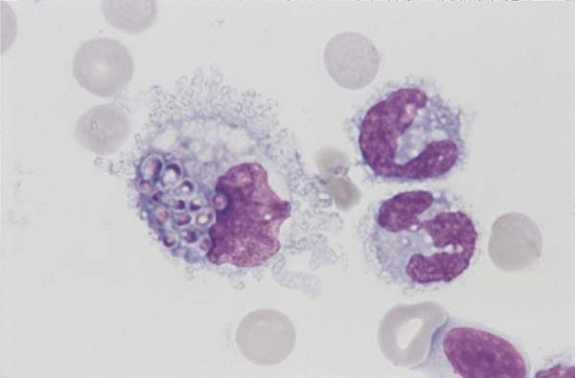
Buffy coat film from a dog. A large macrophage contains phagocytozed Histoplasma organisms.

Slide 40
Monocytosis & Monocytopenia
Normal Monocyte Values: (dogs: 150-1,350/µL; cats: 0-850/µL)
Monocytosis is often associated with:
  Chronic inflammatory conditions (particularly mycotic and other granulomatous infections)
  Endocarditis
  Bacteriemia
  Corticosteroid or stress responses (especially in dogs)
Monocytopenia is occasionally seen but usually has no diagnostic significance.

Slide 41
Lymphocytes
…To be continued.

